Slide 1
BOOKS SALES ANALYTICS DASHBOARD
Name: Riya AM
EMAIL:riyashafi51@gmail.com
Tool Used: Microsoft Power BI
Dataset Source: Book Sales Dataset(Kaggle)

Slide 2
INTRODUCTION
Problem Statement
Dataset Overview
Data Understanding
Data cleaning and Preparations
Dashboard
Key Insights and Findings
Challenges Faced
Limitations and Future Enhancement
Tools & Technologies Used
Conclusion

Slide 3
Problem Statement
Understand sales trends
Identify top-performing books, authors, and genres
Analyze price vs sales relationship
Build a professional dashboard for decision-making

Slide 4
Dataset Overview
Dataset contains book sales information
Key Features Used:
      Book Title
      Author
      Genre
      Publication Year
      Gross Sales
      Units Sold
      Publisher Revenue
      Average Book Rating
      Price Range

Slide 5
Data Understanding
Books are categorized by genres
Sales performance varies across authors and publishers
Ratings help understand customer preferences
Price range affects purchasing behavior
Publication year helps analyze sales trends over time

Slide 6
Data Cleaning & Preparation
Removed blank and duplicate values
Corrected data types
Renamed columns for better understanding
Created KPI measures:
        Total Sales
        Total Revenue
        Average Rating
        Total Unit Sold
Added slicers and filters for interaction

Slide 7
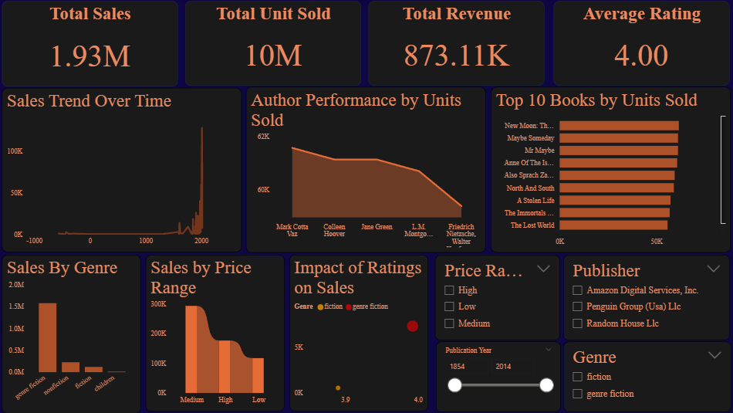

Slide 8
Key Insights & Findings
Some genres generated more sales
Highly rated books performed better
Mid-priced books sold more
Top authors contributed more revenue
Sales changed across years

Slide 9
Challenges Faced
Cleaning the dataset
Creating visuals
Aligning charts and slicers
Designing dashboard theme

Slide 10
Future Improvements
Add sales prediction
Add customer analysis
Use more advanced visuals
Add more datasets

Slide 11
Tools Used
Microsoft Power BI
Power Query
DAX

Slide 12
Conclusion
The dashboard helps understand book sales performance
Interactive visuals make analysis easier
Power BI helped create useful business insights

Slide 13
THANK YOU

